Slide 1


R Visualization and Data Manipulation
Fondren Library
Digital Scholarship Services

Slide 2
ABOUT THE TIDYVERSE
Simple and attractive packages

Slide 3
WHAT IS THE TIDYVERSE?
Hadley Wickham’s brainchild
The most important and influential development in R in the past decade
An ecosystem of packages that hold a similar philosophy about tidy data

Slide 4
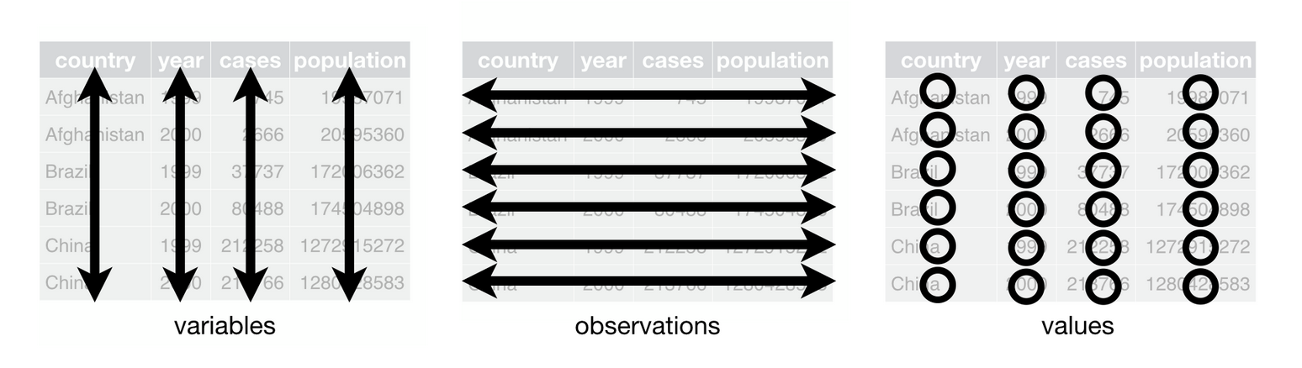
SO, WHAT IS TIDY DATA?
Two rules:
Row is an observation
Column is a variable

Slide 5
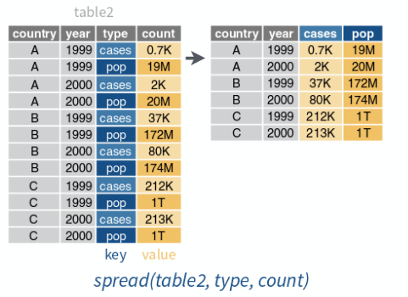
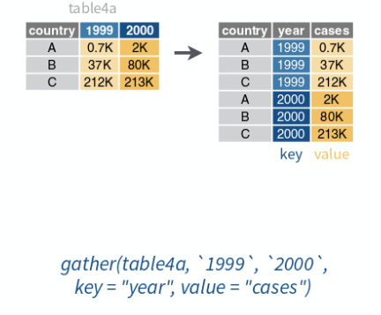
EXAMPLES OF UNTIDY DATA

Slide 6
TIDYING UP
spread
If there are two columns worth of data in one column
spread(table, TYPE OF OBSERVATION, VALUE)
gather
If one column worth of data is spread across many columns
gather(table, firstcol, secondcol, columnname1, columnname2)

Slide 7
DATA STORAGE WITH TIBBLES
A modernized approach to data frames

Slide 8
WHY TIBBLES?
Fixes many annoyances with base R
stringsAsFactors
Partial column name matching
Unhelpful printing
Very easy to use with all the packages we are going to talk about today!

Slide 9
CONVERTING TO TIBBLES
Convert an existing data.frame to a tibble:
as_tibble(df)
Convert an existing tibble to a data.frame:
as.data.frame(tbl)
Typical asymmetry
Base R uses periods a lot
Tidyverse prefers underscores

Slide 10
MAKING TIBBLES
Column approach
tibble(colname1=c(…), colname2=c(…))
Row approach
tribble(
~colname1, ~colname2,
val1, val2,
val3, val4,
)

Slide 11
ACCESSING TIBBLES
Columns:
tbl$colname
select(tbl, colnames): returns a tibble
pull(tbl, colname): returns a vector
Rows:
tbl[index, ]
slice(tbl, index)
Note: the first options are inherited from base R, the other options are from the dplyr package of the tidyverse

Slide 12
DATA ACQUISITION WITH READR
Fast, simple, and instantly in the tidyverse!

Slide 13
READING DATA, TIDY-STYLE!
read_csv(“filename”)
Also, csv2 (;), tsv (tabs), and more
read_fwf(“filename”, fwf_widths(c(3, 5, …)))
Other libraries for reading xlsx, json, xml and more!
readxl, tidyjson, XML
Base R: read.csv, read.fwf, etc.
Much slower!
data.frame, not tibble

Slide 14
VECTOR MANIPULATION WITH PURRR AND FURRR
Functional and expressive operations

Slide 15
THE FUNCTIONAL APPROACH
Focus is on the operation, not iteration
More concise
purrr vs. for loops:
purrr is extremely easy to parallelize, much cleaner and more expressive

Slide 16
MAP
Apply an operation to everything in a vector (column)
Function can be passed as either:
Any function that takes one argument
e.g. tolower(x), which converts a string of characters to lowercase
Any function can be passed as a formula
Lambda / Anonymous function
Start with ~ to indicate formula
.x is the name of the parameter of the function
~ 3 + 5 * .x
map(a, ~ 3 + 5 * .x) will take each value in a and multiply it by 5, then add 3!

Slide 17
MAP2
Apply an operation to everything in two vectors (column)
Function can be passed as either:
Any function that takes two arguments
e.g. max(x, y), returns the larger
Any function passed as a formula
Lambda / Anonymous function
Start with ~ to indicate formula
.x and .y
~ 3 * .y + 5 * .x
map2(firstname, lastname, ~ paste(.x, .y)) will concatenate corresponding strings!

Slide 18
DELETE AND KEEP
Only get the data you really want
Formulas again!
delete(gpas, ~ .x < 2.0)
keep(gpas, ~ .x > 3.8)

Slide 19
EVERY AND SOME
Summarize a list
Is a condition always true?
Is a condition ever true?
What do you know? Formulas again!
every(gpas, ~ .x < 2.0)
some(gpas, ~ .x > 3.8)

Slide 20
MODIFY IF
Only change certain values
modify_if(vector, condition, operation)
modify_if(stateareas, ~ .x > 50000, ~ .x / 2)

Slide 21
EASY PARALLELIZATION
Run many tasks at the same time
Considerable speedup!
furrr: leverage parallel computation for purr
Add plan(multiprocess) to your script
Just use future_map over map, and similarly for other functions!
e.g.:
future_map(names, tolower)

Slide 22
DATA MANIPULATION WITH DPLYR
A vocabulary of common actions

Slide 23
FILTER
Subsetting a data frame
filter(tbl, condition)
Use column names as-is
filter(states, Area > 50000)
Can use multiple column names!
drop_na(): a special case for deleting any row that has a missing value

Slide 24
MUTATE AND TRANSMUTE
Create new columns
Similar to purrr’s mapping functions
mutate: add column
transmute: delete everything but column
mutate(df, newcol = oldcol * 2)

Slide 25
USING PURRR WITH TIBBLES
purrr can be extremely useful when you’re dealing with data tables as well!
statedata$Area <- modify_if(statedata$Area, ~ .x > 50000, ~ .x + 20)

Slide 26
ARRANGE
Sort rows by some criterion
Specify as column name
arrange(states, Area)
Use desc() to switch order!
arrange(states, desc(Area))

Slide 27
JOIN / MERGE
Combine data from two different tibbles!
Must share one column name. Specify this as the “by” argument.
Inner: keep only rows that are in both
Left: keep all rows in first tibble, even if they don’t have a match
Right: keep all rows in second tibble, even if they don’t have a match
Full: keep all rows
Note: if there is no match, NA is the default!
inner_join, left_join, right_join, outer_join
*_join(tbl_1, tbl_2, by=“common column name”)

Slide 28
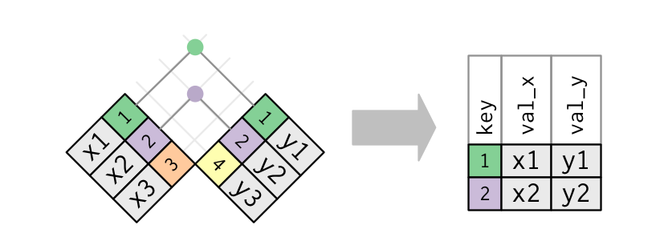
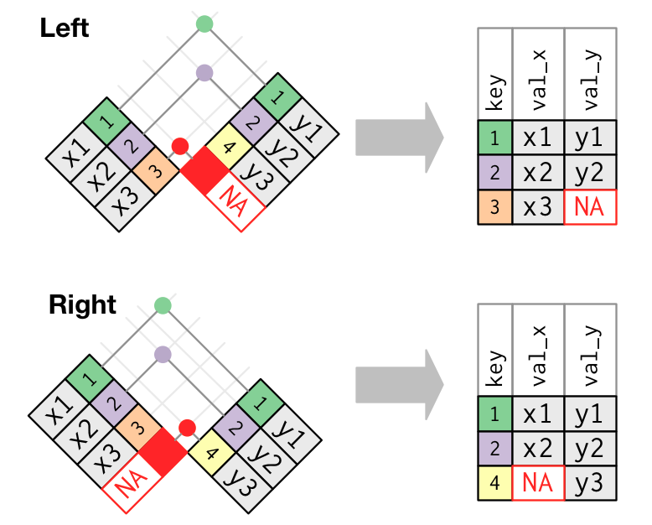
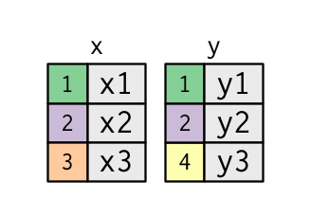
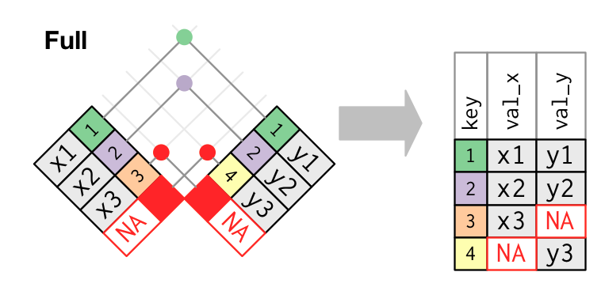
JOIN / MERGE: VISUALLY

Slide 29
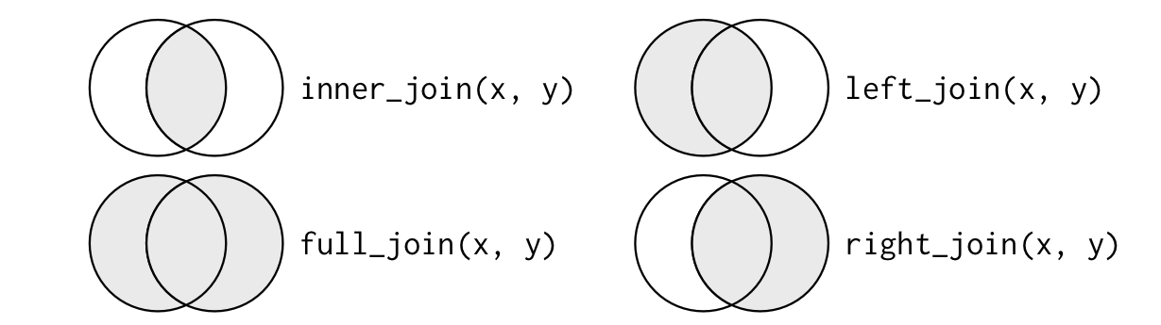
JOIN / MERGE: VENN DIAGRAMS

Slide 30
GROUP BY
Group by a categorical variable
Won’t immediately change the tibble
group_by(students, major)
Use count() to make sure the group_by worked
Then, add a different summary function!

Slide 31
SUMMARIZE
Calculate a measurement of a vector
mean, median, range, etc
summarize(tbl, colname=mean(column))
summarize_all(tbl, summary): apply to all columns
summarize_all(states, mean)
Common grouping operations:
n_distinct -> number of unique rows
sum
min, max

Slide 32
THE PIPE
Easily combine many operations
%>% at the end of a line (not the start of the next one!)
magrittr package
Chains operations together by passing along the first argument
Example:
states %>%
filter(Area > 50000) %>%
mutate(density = Population / Area) %>%
summarize(avg=mean(density))
Instead of
summarize(mutate(filter(states, Area > 50000), density=Population / Area), avg = mean(density))

Slide 33
VISUALIZING DATA WITH GGPLOT2
Versatile and customizable plotting

Slide 34
THE LAYERED PLOTTING MODEL
Add aspects of the plot, one-by-one
Most plotting programs make you decide on everything at once
Coordinate system, type of plot, labels, facets….

Slide 35
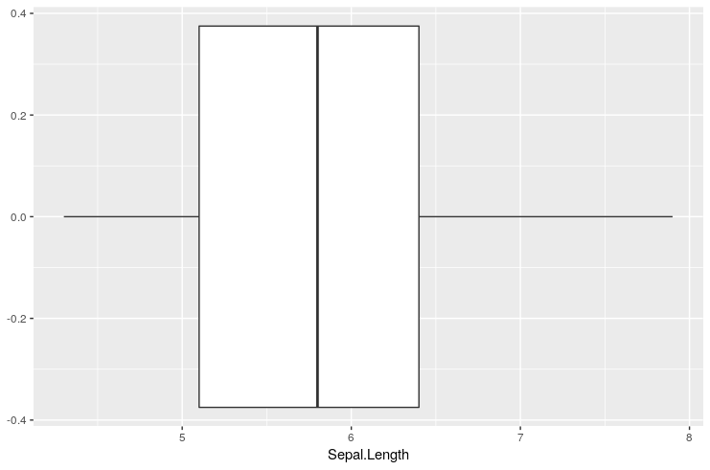
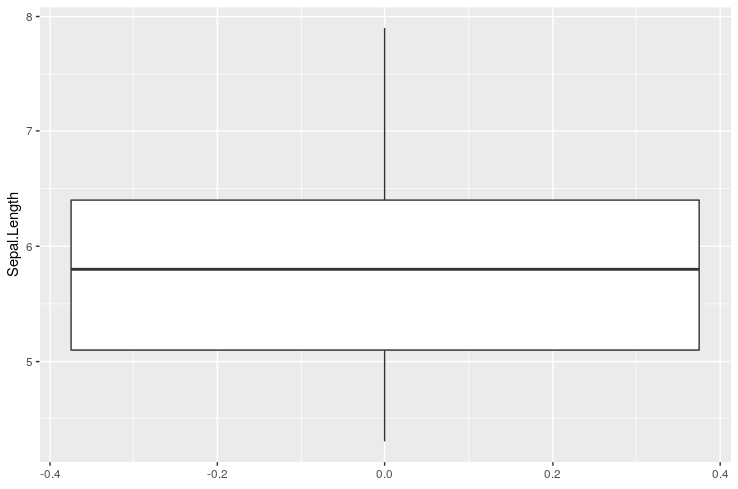
COORDINATES
Created when you call ggplot(data = …)
Changed by coord_flip() and coord_polar(), for example

Slide 36
MAPPINGS
How to tell ggplot what you want to use your data as
Usually, x = …, and y = …, color = …
ggplot(data = iris, mapping = aes(x = Petal.Length, y = Petal.Width, color = Species))
This means we’ve assigned the x value the lengths of the irises’ petals, the y value the widths of the irises’ petals, and the color to the species.
Note this doesn’t yet make a plot! We have to specify what to do with our mapping.

Slide 37
PLOTS (GEOMS)
All plotting functions in ggplot start with geom_, to indicate they contain some geometric information in them
Examples: scatterplots (geom_point), boxplots (geom_boxplot), histograms (geom_histogram)
e.g.
ggplot(data = iris) +
geom_point(mapping = aes(x = Petal.Length, y = Petal.Width))

Slide 38
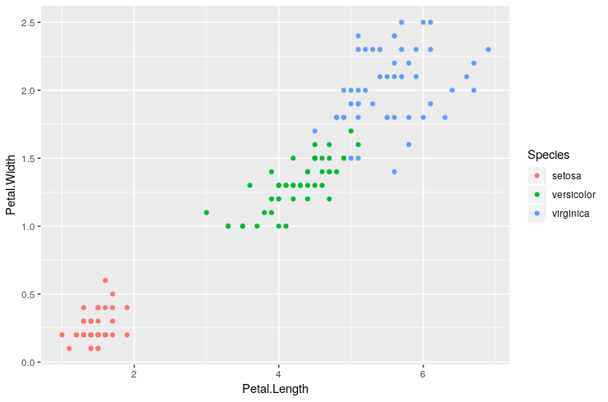
PLOTS (GEOMS): SCATTERPLOTS
Scatterplots are made with the geom_point() function
Needs aesthetic mapping for x and y. Can use color as well!
ggplot(data = iris) +
geom_point(mapping = aes(
x = Petal.Length,
y = Petal.Width,
color = Species))

Slide 39
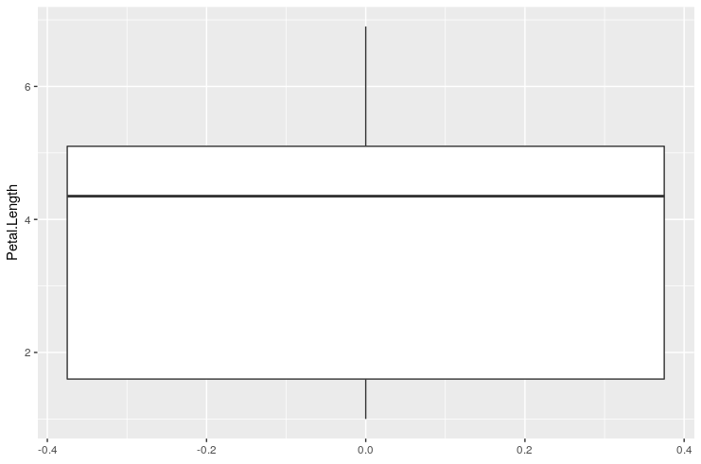
PLOTS (GEOMS): BOXPLOTS
Boxplots are made with the geom_boxplot() function
Only needs y mapping.
ggplot(data = iris) +
geom_boxplot(
mapping = aes(
y = Petal.Length
)
)

Slide 40
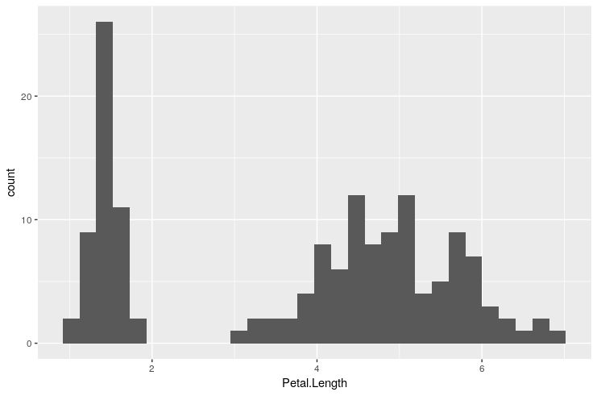
PLOTS (GEOMS): HISTOGRAMS
Histograms are made with the geom_histogram() function
Only needs x mapping.
ggplot(data = iris) +
geom_histogram(
mapping = aes(
x = Petal.Length
)
)

Slide 41
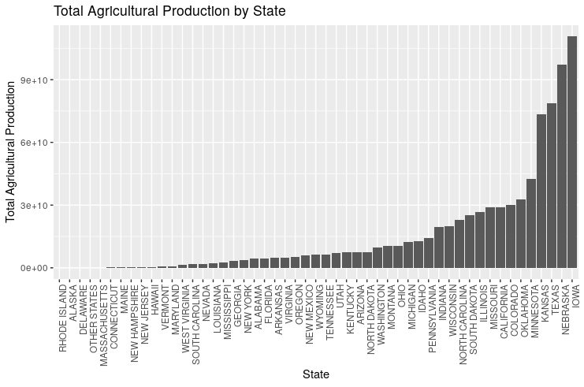
PLOTS (GEOMS): BARCHARTS
Bar charts have categorical data on the x-axis, and some value on the y-axis.
Use geom_col() with appropriate aes mapping
For discrete data, especially for bar charts, you might want to rotate your axis labels!
theme(axis.text.x = element_text(angle = 90, hjust = 1))

Slide 42
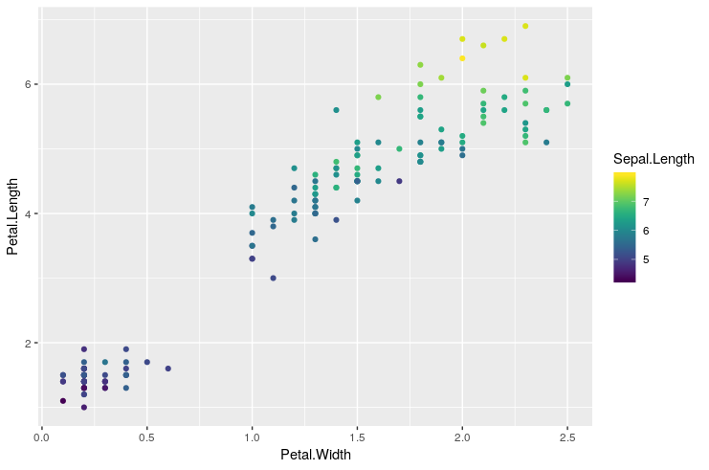
COLORS
You can color points two ways to get a ‘third dimension’ on your plots:
Continuous: color = column, then add a color scale with scale_color_viridis() or something similar
Discrete: color = column in aes()

Slide 43
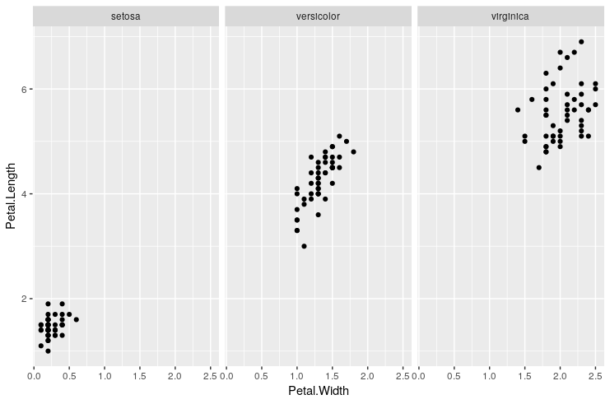
FACETS
Instead of coloring third variables, you can also make grids of plots for each categorical group of the data
Needs a formula! Specify the column with a ~ before it
facet_wrap(~ colname) or
facet_grid(~ colname)

Slide 44
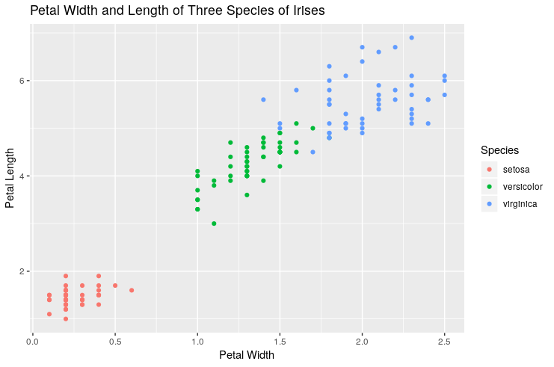
LABELING
labs(title=“”, x=“”, y=“”)
Add axis titles:
x=“title” and y=“title”
Main title:
title = “title”
subtitle = “title”

Slide 45
PUTTING IT TOGETHER
ggplot uses + to link several layers
Just like the pipe, you can combine tons of these together!

Slide 46
ALL TOGETHER NOW
Integrating all the components

Slide 47
A FULL TIDYVERSE WORKFLOW
You can combine %>% and + to get long, but very readable chains of commands!
However, don’t just rely on these alone.
If you have too many commands at once, it becomes easy to lose track.
Add intermediate variables with meaningful names!

Slide 48
ACKNOWLEDGEMENTS
Much of this tutorial is based on Hadley Wickham’s Amazing R For Data Science, available for free at https://r4ds.had.co.nz
The tidyverse hex stickers are used under the terms of the Creative Commons 1.0 Universal license.

